Slide 1
WiRED
Home Automation for IR Appliances

Slide 2
Problems
Missing TV remotes in common rooms
Forget to switch on the DVR
Return to a sweltering room on a hot day
Busy school days

Slide 3
What is WiRED?
“Universal Remote” application
Control over IR appliances from almost anywhere
Proof of concept
Idea can be extended or specialized to suit related needs
Easily extendable and customizable

Slide 4

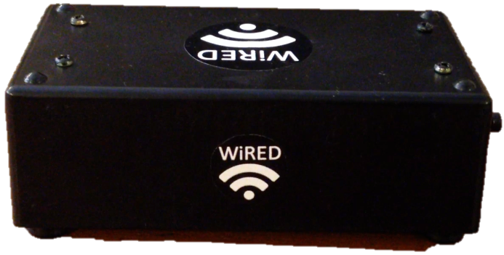
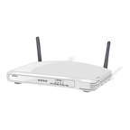


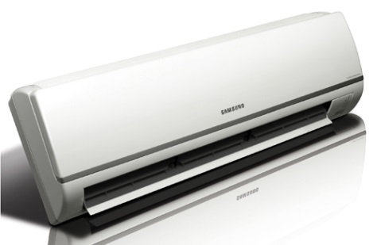



WiRED System
Cloud Server
WiRED Device
Wi-Fi
Internet
WiRED Application
IR Appliances

Slide 5
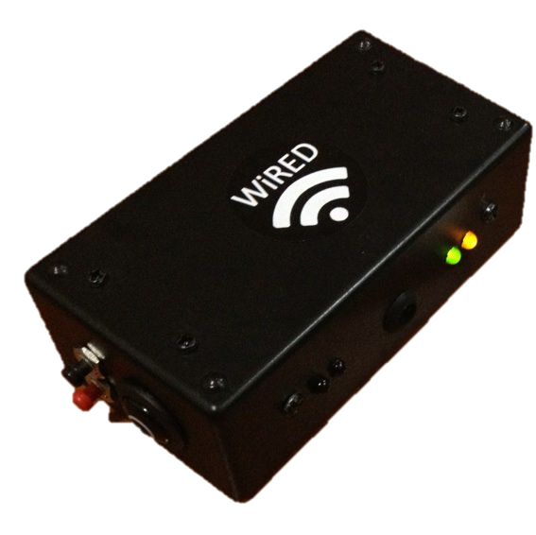
The WiRED Device Prototype

Slide 6
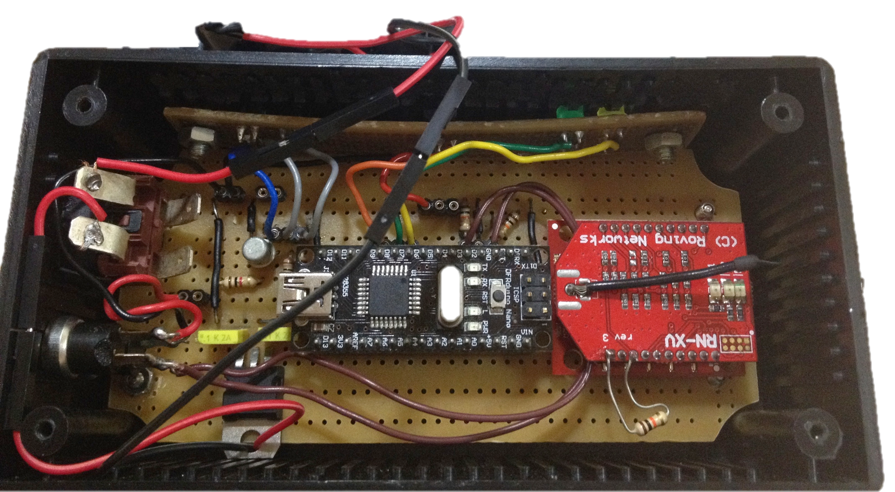
Internals

Slide 7
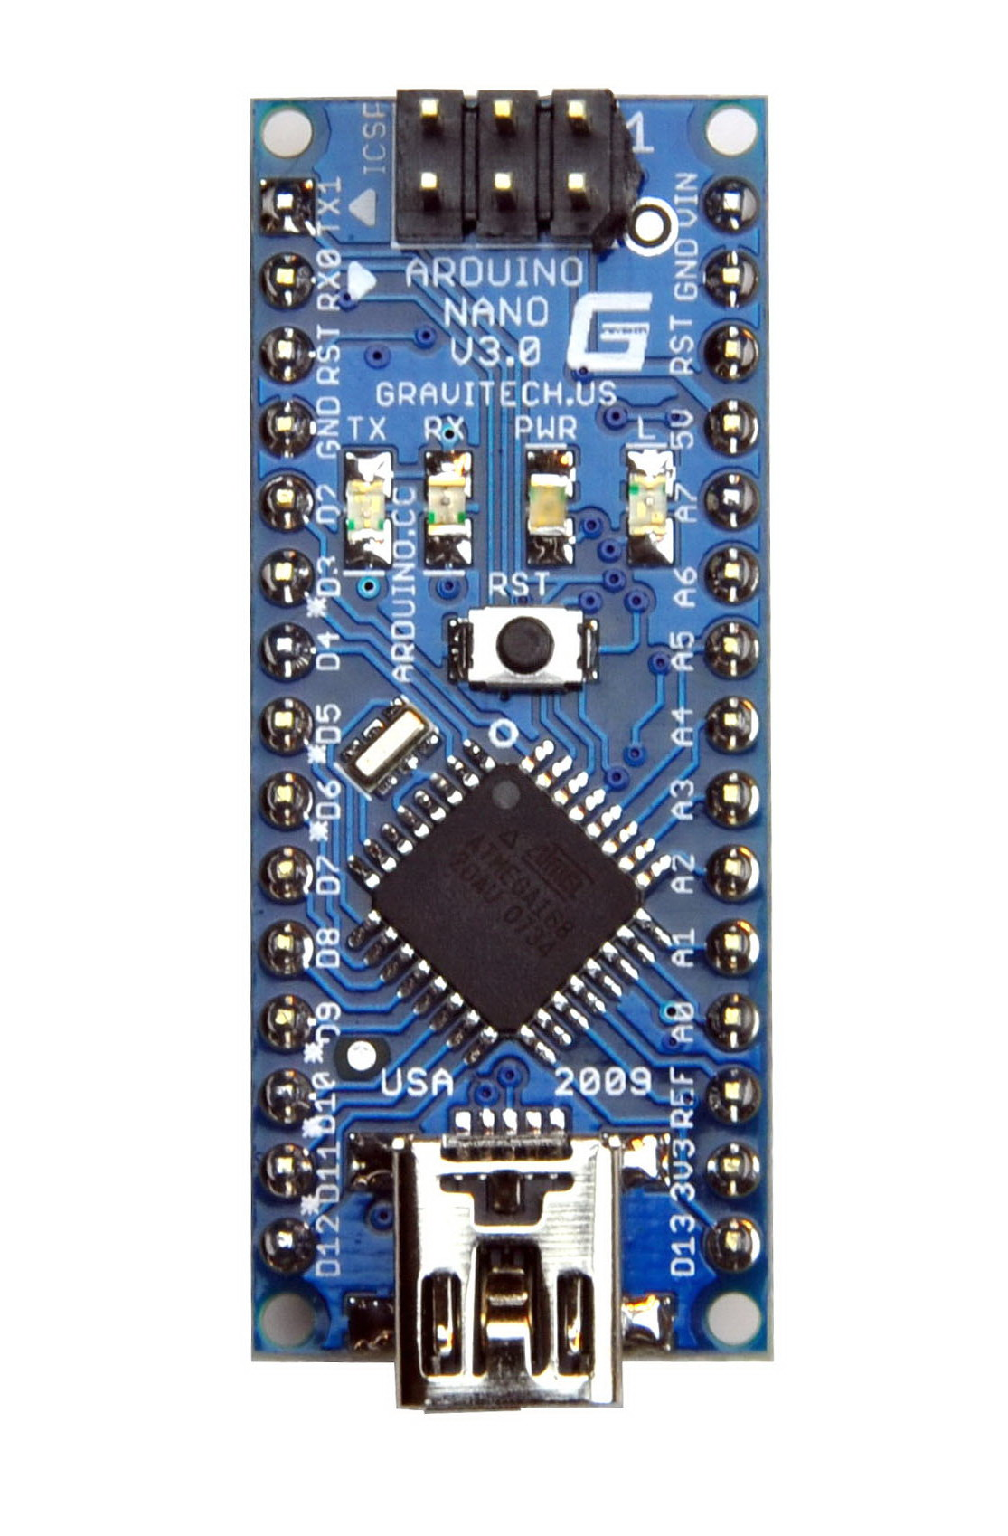
Atmega 328P Microcontroller
Uses the open source Arduino Libraries such as Arduino 1.01, Timer Library and IRRemote Library and the Nano Development platform
All Code is written in pure C++ and is compiled on Atmel Studio
Easy to use Hardware API’s that allow communication with the IR Sensors and Wireless Modules
Cost of an Atmega 328P Chip (5 USD)

Slide 8
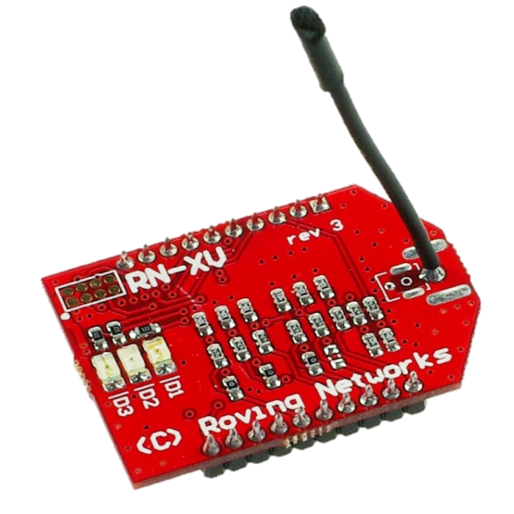
WiFly RNXV Wireless-N Module
Wireless Module that uses the Roving Wireless chipset
Performs TCP Communications with WiRED Server and also listens to commands from WiRED Server
Acts as an EEPROM to hold authentication data and WiFi data
Extremely low power consumption (100mA on load)
Communicates and works together with the Atmega 328P Microcontroller
Cost an an RNXV Module (30 USD)

Slide 9



IR System Components
Uses a standard range IR Transmitter, a IR Receiver tuned at 38khz and a standard NPN BJT for amplification.
Microcontroller performs modulation of IR Signal when sending
IR Receiver performs demodulation of IR Signal when receiving
Extremely low power consumption (10mA on load)
Communicates and works together with the Atmega 328P Microcontroller
Cost of components (10 USD)

Slide 10
The WiRED Device Prototype
Low-cost (60 USD)
Small and Compact

Slide 11

Server and App

Slide 12

Server
Powerful highly multi-threaded server
Makes use of the H2 Database Engine for SQL Database handling
Concurrently handles communications with hardware, app, scheduling and web requests
Makes use of Queues, Threads, Thread Pools and other data structures and techniques to ensure smooth operation
Easy to use and portable single .jar file that is < 12MB
Full RESTful API Service
Can even be easily deployed by a home user. Currently runs on Amazon Web Services

Slide 13
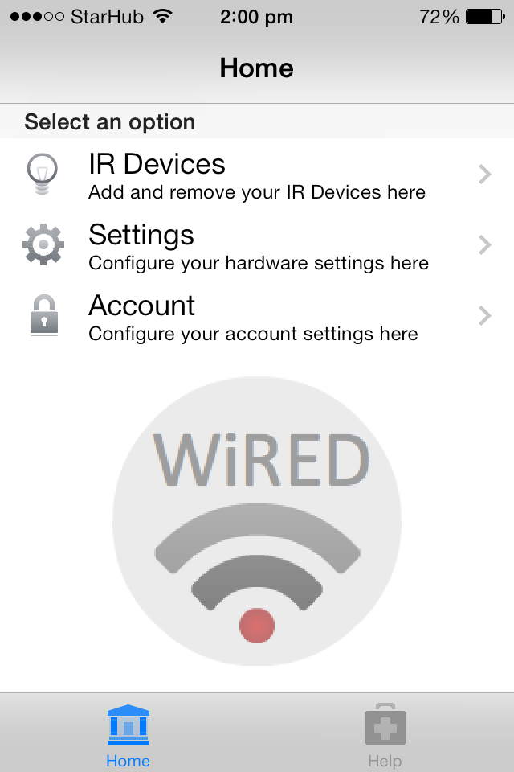
App Home Page

Slide 14
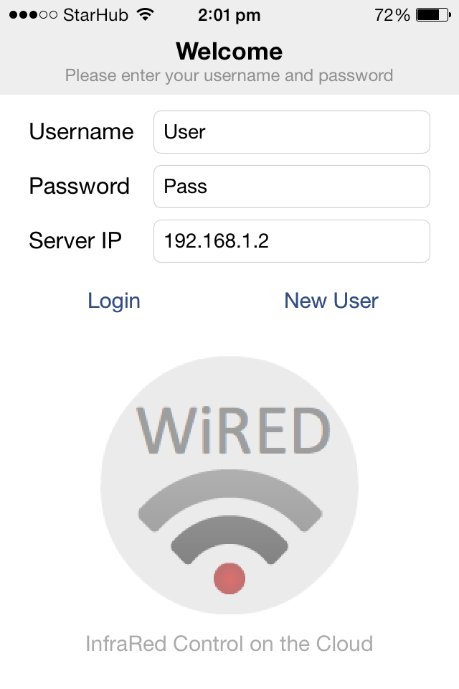
App Login Page

Slide 15
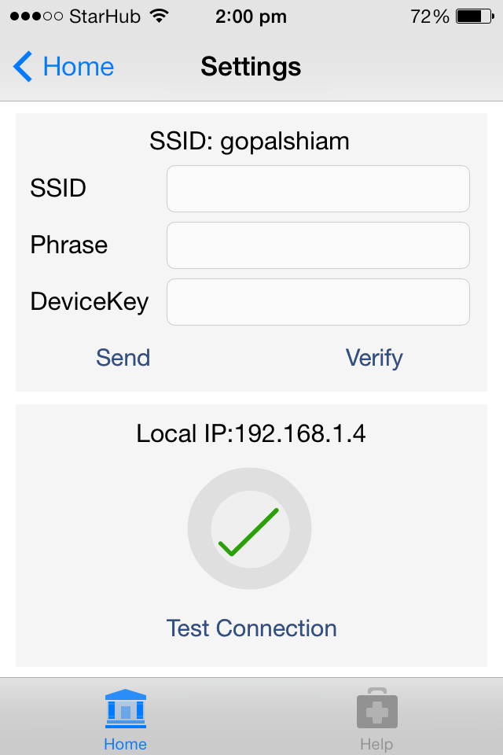
WiRED One-touch Configuration

Slide 16
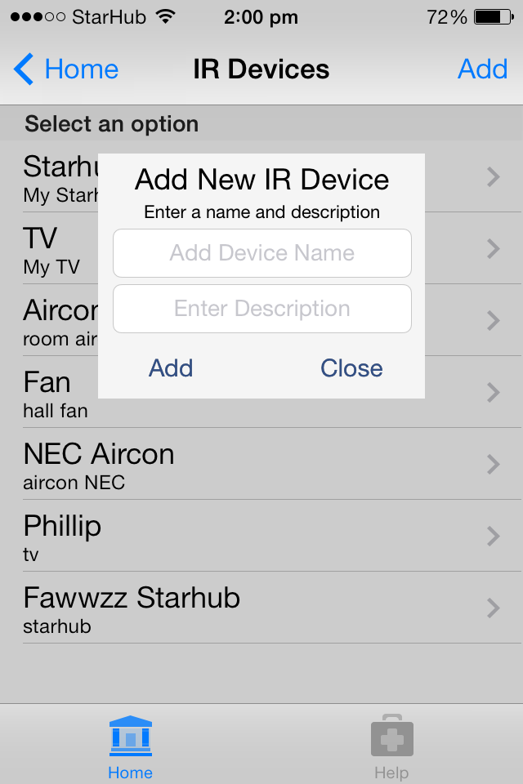
All your IR Devices on the cloud

Slide 17
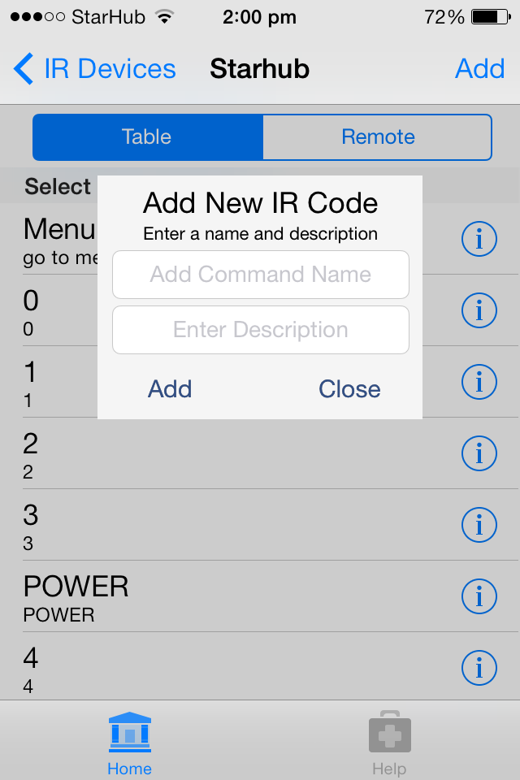
Manage your IR Commands

Slide 18
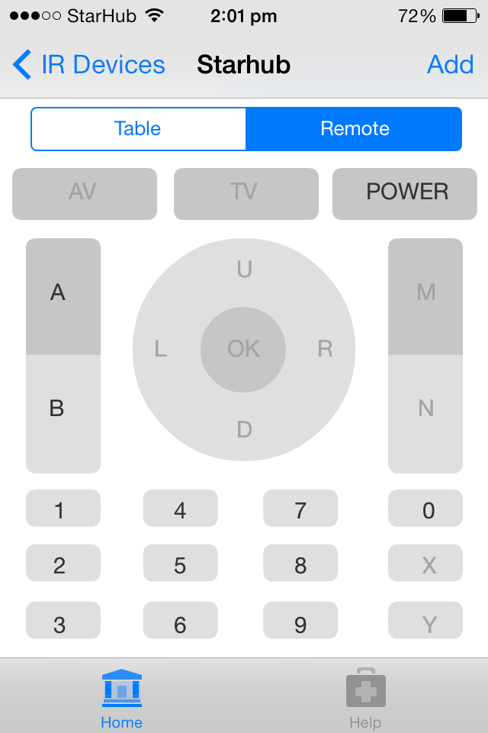
Virtual Remote

Slide 19
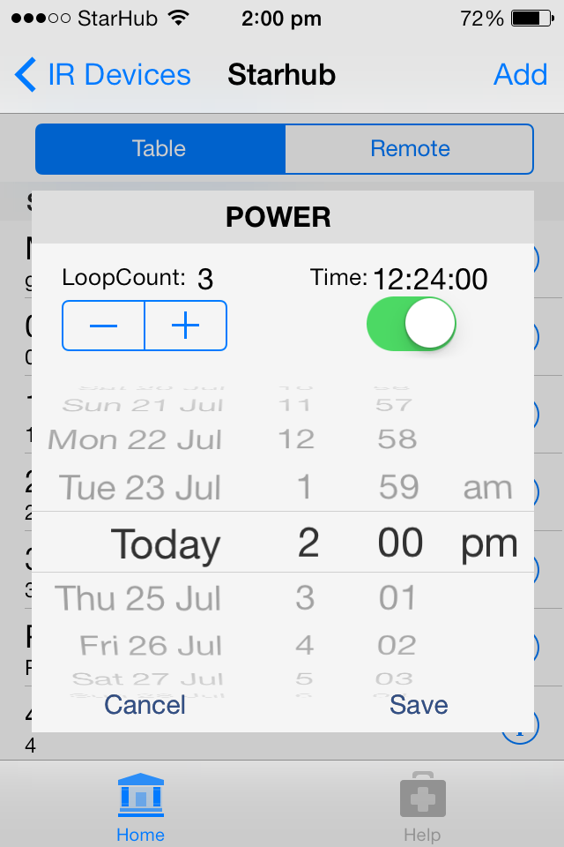
Scheduling

Slide 20
Demo

